Slide 1


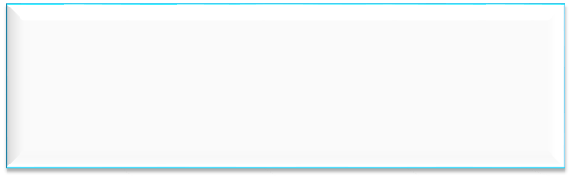

Mini Project Presentation
Development Of Line Following Robot
Varsha.V
Sneka.P
Sanjay.S
Project Guide:
Dr. MANGALA GOWRI
Associate Professor, Dept of ECE, Atria IT,
Bangalore
Department of Electronics & Communication Engineering,
Atria Institute of Technology, Bangalore
Mini Project Presentation

Slide 2
Presentation Overview
Introduction
Literature review
Problem statement
Project overview with block diagram
Methodology
Expected Outcome
Obtained output
Applications
References

Slide 3
Introduction
Line following robots are designed to follow lines on surfaces using infrared sensors.
They use an IR transmitter and receiver to detect reflected light from white surfaces and absorbance on black surfaces or remote control.
These robots can be controlled using voice commands through an Android device.
The demonstration of line following robot can be represented as smart dustbin dut.
The design, assembly, and simulation of these robots are done using Arduino software

Slide 4
Literature Review
Authors | Title, Contributions and Observations
Jagruti Chaudhari, Asmita Desai, S. Gavarskar, ICCT,IEEE 2019. | “Line Following Robot Using Arduino for Hospital”, The LFP using Arduino for transportation inside the health care institution.
Alfian Maarif, Aninditya Anggari Nuryono, Iswanto, FORTEI, IEEE 2020 | “Vision-Based Line Following Robot In Webots”, The line following robot aims to detect image based lines and to navigate the robot to follow the path.
Saharsh Oswal1 and Saravanakumar, School of Mechanical Engineering, Vellore Institute of Technology, India 2021. | “Line following robots on factory floors”, Significance and Simulation study using Coppelia Sim. Studying and working on LFR.

Slide 5
Problem Statement
Before the invention of line following robots, there were several challenges and limitations in various fields that required automated systems.
Manual Labour.
Lack of Precision
Limited Flexibility
Safety Risk
These robots helped improve efficiency, reduce costs, enhance safety, and open up new possibilities for automation and research in various industries and fields.

Slide 6
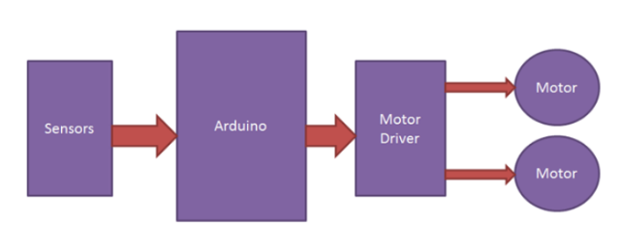
Proposed block diagram
Fig1:line following robot and dut

Slide 7
Methodology
1
The program is dumped into the Arduino which acts a brain of the robot.
2
The robot moves either by following line, voice-controlled, remote-control.
3
The program is dumped in the Arduino to develop smart dustbin.
4
The robot carries the dustbin and the user controls the robot as per user’s requirements.

Slide 8
Expected Outcomes Of The Project
The overview outcomes from the line following robot and dut are:
Accurate Line Tracking
Voice-controlled robot
Real-Time Decision Making
Remote controlled robot
Energy Efficiency.

Slide 9
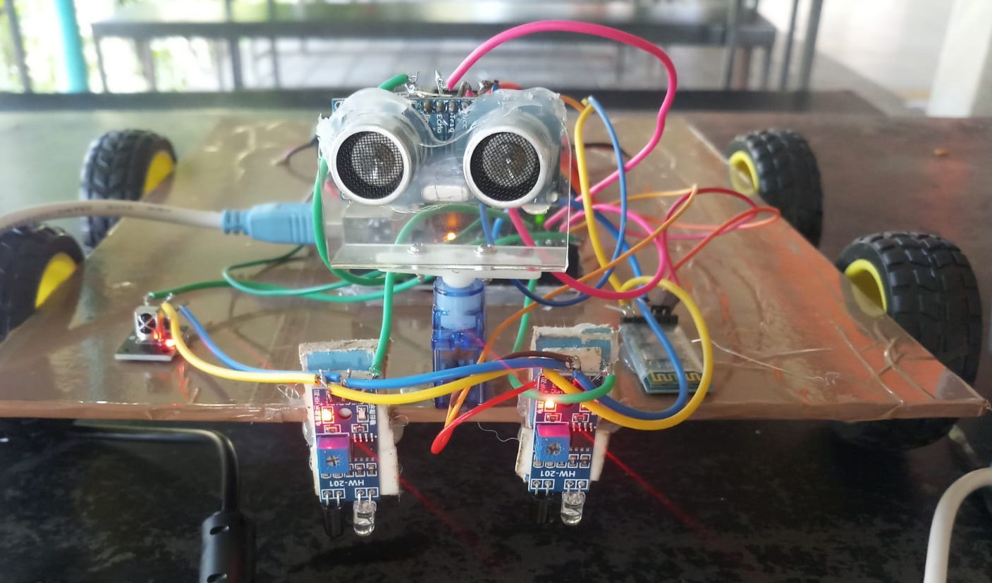
Obtained Output
The line following robot can sense the path by IR sensor.
The infrared receiver is also activated and the development of dut also activated successfully.

Slide 10
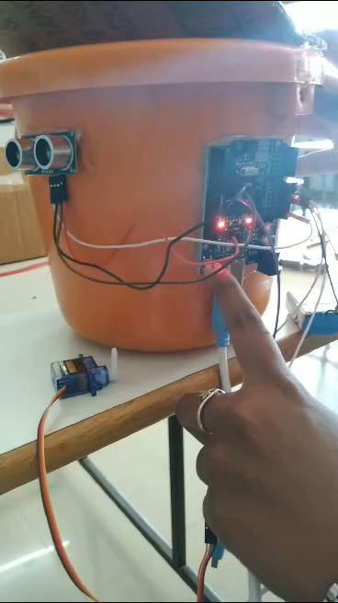
Obtained Output

Slide 11
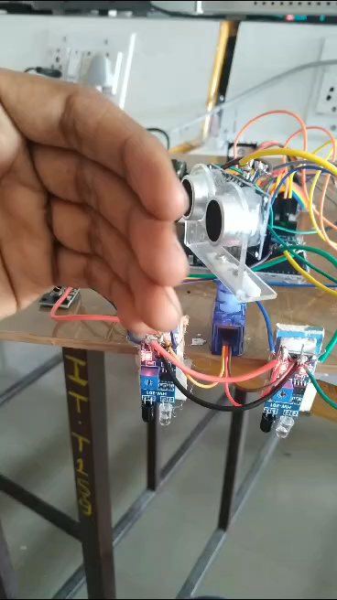
Obtained Output

Slide 12
Applications
Some of the major fields in which the line following robot and dut are:
Industrial Automation
Food and Beverage Industry
Medical Facilities
Cleanliness and Maintenance
Education and Research
Waste Management Optimization
Smart City Initiatives.

Slide 13
References
“Line following robots on factory floors”, Significance and Simulation study using Coppelia Sim. Saharsh Oswal1 and Saravanakumar ,School of Mechanical Engineering, Vellore Institute of Technology, India 2021.
“Vision-Based Line Following Robot In Webots” Alfian Maarif, Aninditya Anggari Nuryono, Iswanto, FORTEI, IEEE 2020.
“Line Following Robot Using Arduino for Hospital”, Jagruti Chaudhari, Asmita Desai, S. Gavarskar, ICCT,IEEE 2019.

Slide 14
Thank You

